Slide 1
Regulation of Flavors in E-cigarettes:
Methods, Findings, Meaning
Jody Sindelar, Presenter
Yale School of Public Health
Coauthors on various papers in the series:
J. Buckell, A. Friedman, K. Strombotne, J. Marti, J.C. Maclean
Thank you to the organizers of TOPS, seminar series is a great idea.

Slide 2
Report on some in our series of publications on regulations of smoking and vaping and related.
Strombotne K, Buckell J, Sindelar JL. Who me? Optimism bias about US teenagers’ ability to quit vaping, submitted.
Sindelar JL, Regulating Vaping: Policies, Possibilities and Perils. N Engl J Med. May 2020.
Strombotne K, Buckell J, Sindelar JL Strombotne K, Buckell J, Sindelar JL. Do JUUL and e-cigarette flavors change risk perceptions of adolescents? Evidence from a national survey. Tobacco Control. 2020.
Friedman AS, Buckell J, Sindelar JL. Tobacco-21 laws and young adult smoking: quasi-experimental evidence. Addiction. 2019 Oct;114(10):1816-1823.
Buckell J, Sindelar JL. The impact of flavors, health risks, secondhand smoke and prices on young adults’ cigarette and e-cigarette choices: a discrete choice experiment. Addiction. 2019 Aug:114(8):1427-1435.
Friedman AS, Buckell J, Sindelar JL. Patterns of Youth Cigarette Experimentation and Onset of Habitual Smoking. American Journal of Preventive Medicine. 2019 Jun;56(6):803-810.
Buckell J, Hess S. Stubbing out hypothetical bias: improving tobacco market predictions by combining stated and revealed preference data. Journal of Health Economics. 2019 May;65:93-102.
Marti J, Buckell J, Maclean JC, Sindelar JL. To ‘vape’ or smoke? Experimental evidence on adult smokers. Economic Inquiry. 2019 Jan;57(1):705-725.
Buckell J, Marti J, Sindelar JL. Should flavours be banned in cigarettes and e-cigarettes? Evidence on adult smokers and recent quitters from a discrete choice experiment. Tobacco Control. 2018 May 28.

Slide 3
Disclosures
Funding: NIH, Yale TCORS, NIDA, FDA Center for Tobacco Products (CTP)
No funding from tobacco or related companies.
Acknowledgement for many of our papers:
Research reported in this publication was supported by grant numbers P50DA036151 and U54DA036151 from the National Institute on Drug Abuse (NIDA) and FDA Center for Tobacco Products (CTP). The content is solely the responsibility of the author(s) and does not necessarily represent the official views of the National Institutes of Health or the Food and Drug Administration.

Slide 4
Plan and Purpose of Presentation
‘Grand rounds style’- use the accumulated knowledge across my/our studies for policy discussion; focus on one study in part to explain methods of DCE. Others show findings.
Background key policy issues in regulation of flavors.
Overview of 1 study mainly and another one- both Discrete Choice Experiments (DCE) on the impact of regulation of flavors on vaping and smoking.
Next study. Consider impact of state flavor bans and Tobacco 21 policies at state level to understand future impact at federal level.
Over-view of evidence needed for policy purposes. Meaning of results.

Slide 5
Background and Policy Issues: How to best regulate flavors in e-cigarettes
Key policy issues:
Generally: How best to regulate all tobacco products- in advance of policy selection.
Policy levers: flavors, nicotine levels, taxes/price, healthiness of ecigs; Tob 21. else
Specifically: How to regulate flavors in e-cigarettes to prevent youths from vaping while allowing them to help smokers to quit. (max public health impact)
E-cigarettes and JUUL. Key concern, rapid growth among youths, undermine LR decline in smoking rates.
Examine flavor bans in context of other regulations, control for them & are of interest.
We aim to provide needed information prior to decision-making by the FDA.
Current research to examine state flavor bans to predict impact of FDA policies.
Team: Jamie Tam, John Buckell, Rafael Meza, David Mendes, David Levy

Slide 6
Background Flavored JUULs and E-cigarettes
E-cigarettes came into the US market 2006/7.
JUULs first sold in 2015; 75% market share at peak 2015
Claims to help smoker quit, but market to youths
Attract young people; generally non-smoking youths
Sleek, appealing, teen-appealing flavors.
Restricted sales of some flavored pods to online only, 2018
Mango, fruit medley, crème brulee, cucumber
Available in stores- tobacco, menthol and mint
All available online

Slide 7
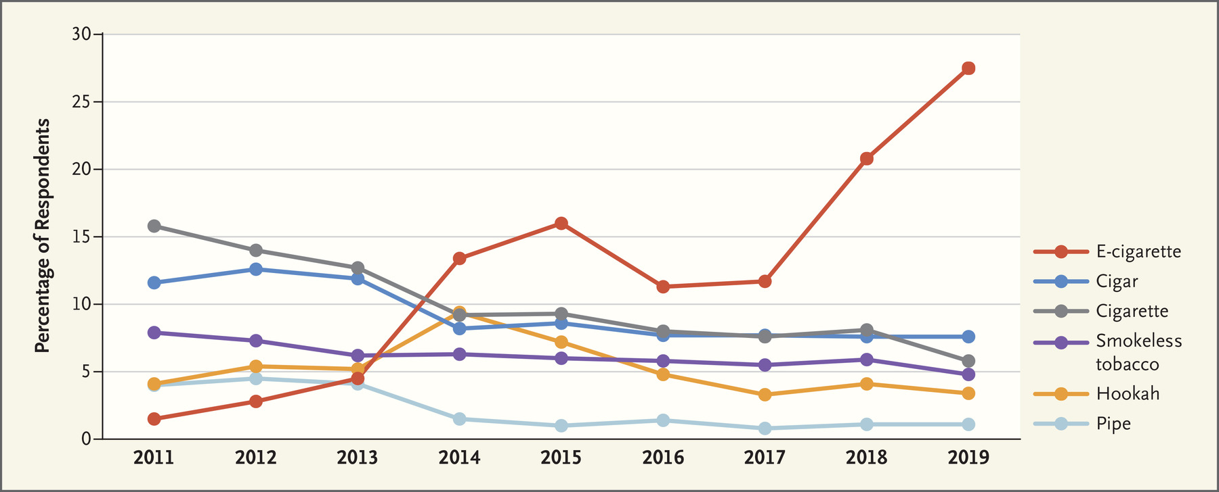
Current Tobacco Product Use among US High School Students, 2011- 2019. Data are from the National Youth Tobacco Survey and were provided by the Centers for Disease Control and Prevention. (past 30 days)
Growth in vaping by high school students undermines the decline in smoking and use of other tobacco products
Notes:
NEJM 1-2020. The EVALI and Youth Vaping Epidemics — Implications for Public Health.
Brian A. King., Christopher M. Jones,., Grant T. Baldwin,., and Peter A. Bris

Slide 8
Why Flavor Regulation as a Focus in Vaping?
Flavors in e-cigarettes
Attract youths
Misperceive the harm of ecigs suggests healthier than ccigs; Fruit flavors thought of as healthier (Strombotne, Buckell, Sindelar 2020).
Menthol less harsh. Mint ditto. Appeal to youths.
Can be regulated by FDA, states and localities.
Specifically FDA has ‘premarket enforcement’ power
Could affect smokers quitting rate (but find not much for adults)

Slide 9
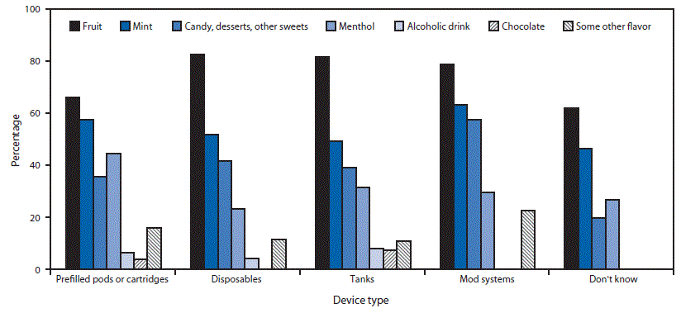
Percentage of flavor types used by current (past 30-day) flavored e-cigarette users among U.S. middle and high school students,* by device type†,§ — National Youth Tobacco Survey, United States, 2020
.
Wang et al. E-cigarette Use Among Middle and High School Students — United States, 2020. MMWR Morb Mortal Wkly Rep. ePub: 9 September 2020. DOI: http://dx.doi.org/10.15585/mmwr.mm6937e1external icon.

Slide 10
Background: Regulation – Federal and State.
(some regulations pre our articles, some post)
FDA
Congressional tobacco control act 2006-gave regulatory power to FDA.
FDA ‘deemed’ control of ecigs 2016.
FDA has authority to enforce ‘premarket control’ over flavored products. Some statements, enforcing staring Sept 13. What will it look like? When will be impact?
Can factor flavors into assessment of impact on public health.
States (and localities)
Flavor regulations after Thanksgiving 2019. E-cigarettes mainly, but also menthol in cigarettes (MA, and soon CA)
Localities- around the same time as states
Federal government implemented Tobacco 21 law, effective January 2020

Slide 11
Aims of this work. Analyze impacts of alternative, future regulations & to provide findings in advance of selection of policies.
New alternative regulations such as bans on flavors in ecigs or cigs cannot be studied using real world data if not have been implemented (was true when started, now there are state regs).
Want population-based impact but also by key groups, e.g. youths, African American smokers (re menthol in cigs).
Need timely data as the tobacco landscape changes rapidly.
Need to understand trade-offs and unintended impacts, e.g. substitute to unregulated products.

Slide 12
We Use a Discreet Choice Experiments (DCEs).
Why?
Utility based choices, McFadden, 1974, indirect utility
Provide findings in advance of policy selection
Collect own, purposeful data
Rigorous, well documented methods. E.g..Hauber, et al. 2016 Johnson et al. 2013 Bridges et al. 2011, ISPOR
Timely findings and designed for specific policy to examine
Focus on & estimate trade-offs across policy options and cig types
Use estimates to predict/simulate impact under alternative policies
Examine heterogeneity in responses to regulation; define types
e.g. dedicated smokers, vapers, dual who respond differently
Important difference found

Slide 13
Methods: Discrete Choice Experiment
Examples of other tobacco DCEs
DS Kenkel, et al. Health Economics. 2020
MF Pesko et al. Addiction 2016.
C Shang et al. Tob Control. 2018
C Shang et al. Tob Regul Sci. 2020
Marti J, Buckell J, Maclean JC, Sindelar JL. Economic Inquiry. 2019

Slide 14
DCE 1: How will different flavor bans impact public health?
Buckell, J., Marti, J., & Sindelar, J. L. Should Flavors Be Banned In E-Cigarettes? Evidence On Adult Smokers And Recent Quitters From A Discrete Choice Experiment. Tob. Control 2019, 28.168-175
What would be the best set of flavor bans on ccigs and ecigs?
Ban menthol? All flavors? Maintain status quo?
Ban similarly or optimally different across ccigs and ecigs?
Heterogenous impact by demographics and types of smokers/vapers?
What are goals? Reduce smoking, minimize use of cigs and ecigs by youth?

Slide 15
What we added to previous literature
Predict impacts of alternative flavor bans across ccigs and ecigs using DCE results. Relative value of each attribute and product is derived and used in predictions. Compared impacts across policy options. (also see Marti et al, 2019). Focus on trade-offs across. Substitutes and complements.
Examine ccigs and ecigs. Some studies examine only flavor bans on ccig and impact on ccigs, others examine flavors ban on both types

Slide 16
Sample
2,031 current smokers and recent quitters (might vape, relapse).
Large relative to other DCEs
Had to have smoked at least 100 cigs in lifetime
US residents ages 18-64
Quotas. matched BRFSS 2014 to get national representative sample. based on 6 regions, gender and age bans
Online sample. Qualtrics platform.

Slide 17
DCE Methods and Steps- in general once have study goals and sample
Select attributes and determine ‘levels’. Confirm importance of each, policy-relevant
Determine products to select among
Assess if DCE too difficult, long, demanding, can understand
Develop DCE and survey to accompany DCE. Select the most impactful set of choices. Randomize to groups to reduce response burden.
Increase quality of data e.g. visuals to help explain products, practice questions, not too long nor too complicated, nor to many choice set
Pilot- and use data to design subset of choice set
Field study- choices are the data to analyze
Analyze data

Slide 18
Discrete Choice Experiment in our study
Products:
combustibles, e-cigarettes, “none of these” (opt out)
Attributes and levels
Flavors: tobacco, menthol, fruit, sweet
Nicotine level: high, low, medium (not think respondents would relate to quantitative levels)
Health: die early by years
Price
Notes:
Refs on best DCE practices.
Hauber, et al. 2016
Johnson et al. 2013
Bridges et al. 2011

Slide 19
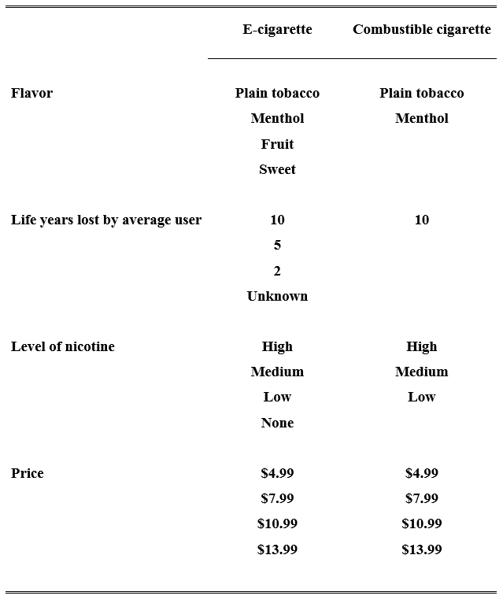
Experimental Design
Products:
combustible cigarettes, e-cigarettes, opt out
Attributes:
flavors, health, nicotine level, price
Levels:
E.g. Flavors tobacco, menthol, fruit, sweet
Nicotine- used qualitative

Slide 20
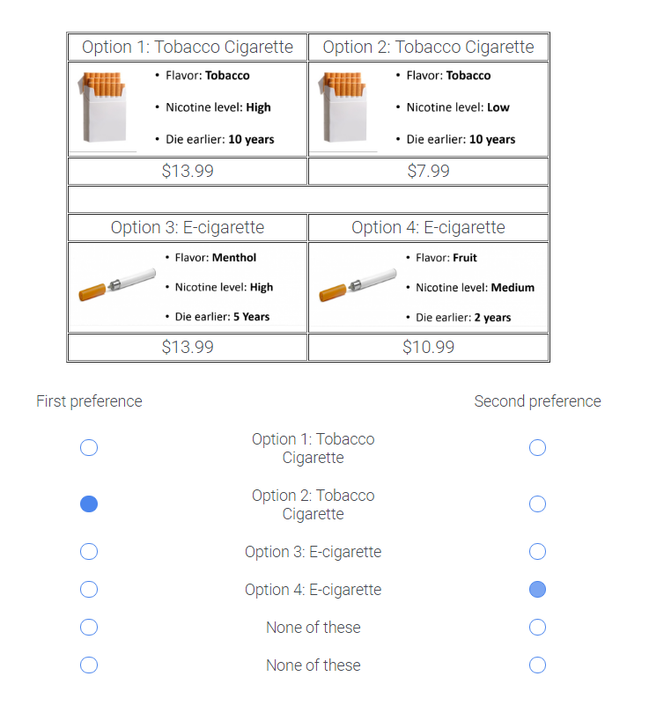
Choice Tasks: best-best (top 2 choices) Online.
Best-best DCE
2 choices per scenario
2 opt outs
12 scenarios per individual-Can’t ask all possibilities. 3 sets to randomize
‘Observations’= 24,372(2 choices for each of 2031 respondents, 12 choices)
Choices are the data to analyze.

Slide 21
Pilot first
Why?
Examine if respondents seem able to answer well, adjust if not
Ask follow-up questions, e.g. what was difficult to answer
Determine average response time; delete respondents who rush through
Use pilot data to optimize choice sets. 36 choice sets was optimal
we randomized 3 groups to mutually exclusive set of 12 each
(Too many in full set of choice options (4 attributes raised to the power of 4 levels: 4*4*4*4=256 possible choice sets!))
Notes:
we use NGene software (http://www.choice-metrics.com/) to develop a D-efficient fractional factorial design, which will use a subset of choice tasks from the full factorial design such that information gained from the chosen choice tasks is maximized. A D-efficient design will balance (near) orthogonality, overlap between choice sets (i.e. the same attribute level in two choices), the presence of dominant or implausible combinations of levels between attributes, and the number of times each level appears in the design. NGene will account for the number of attributes and levels, any potential interaction effects, and dominant choice tasks when constructing the design..

Slide 22
Accompanying Survey Alongside DCE
Why gather data in survey?
Use responses as control variables.
Use to form latent heterogenous groups. Policy relevant
Ask about:
Socio-econ and demographics
Smoking and vaping history and current habit
State and city of residence
Knowledge, beliefs, perceptions re vaping
Specifics developed for each study
Else..

Slide 23
Promoting Data Quality
Promoting Data Quality:
Strategies employed in order to ensure high-quality responses.
Exclude respondents who rush through the survey
Employ attention checks to ensure all respondents are active respondents (not straight-lining).
Use progress bar to prevent dropouts
Check for likely duplicates – Qualtrics checks for same IP address and same socio-econ
Use honesty pledges to increase the likelihood that respondents will complete the survey with fidelity.
Notes:
Was not sure if promoting data quality was meant to be the title, so I added it in that format but didn’t delete it from the body of the slide.

Slide 24
Method of Analysis of Choice Data in this study
Exploded multinomial logit choice model (handles two choices)
Combined fruit and sweet flavors into one variable (policy)
Flavored cigarette type constant terms (combined flavors/products in models)-gives more direct preference measure
Use rich set of sociodemographic/smoking. interactions

Slide 25
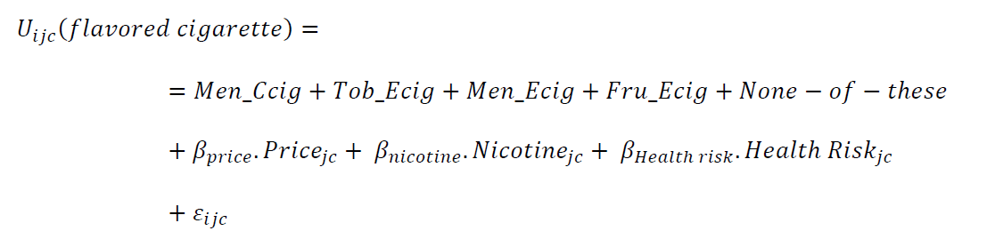
Methods: Choice Model and Utility Function
We build a utility function: (i=individual; j=product in c=choice set)
This yields choice probabilities – higher utility, more likely choice(omitted tobacco-ccig)
Product-flavor constants (interact product constant with flavor preference e.g. menthol-ccig)

Slide 26
Results: Cigarette choice model Cigarette choice model without interaction
Parameters | Coef. (s.e.) | Sig.
Constant: menthol combustible cigarette | −0.38 (0.035) | ***
Constant: tobacco e-cigarette | −0.55 (0.037) | ***
Constant: menthol e-cigarette | −0.88 (0.058) | ***
Constant: fruit/sweet e-cigarette | −0.71 (0.040) | ***
Constant: none of these | −1.87 (0.049) | ***
Price | −0.08 (0.002) | ***
Nicotine: none | −0.15 (0.024) | ***
Nicotine: low | −0.04 (0.019) | *
Nicotine: high | −0.06 (0.015) | ***
Health: unknown | 0.30 (0.033) | ***
Health: 2 life years lost | 0.37 (0.036) | ***
Health: 5 life years lost | 0.18 (0.027) | ***
Results;
Coefficients on constant terms are measures of the preferences.
Sample prefers the omitted category of: tobacco cigs. (negative coefficients on else)
(sample current and recent smokers)
Prefer
Lower price
Medium level of nicotine
Healthier product

Slide 27
Examine Heterogeneity
Interact flavor-product-constant with sociodemographic variables to examine heterogeneity
Use these results to predict impacts

Slide 28
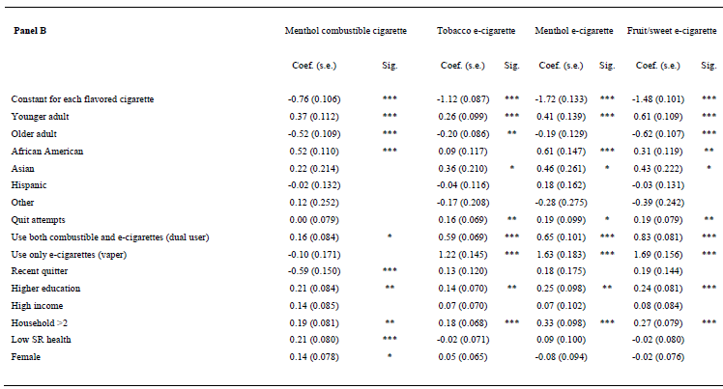
Results: Model Estimates, Exploded logit
Preferences vary substantially
Find: older adults not like flavors, younger do
Similar (where comparable) to other findings. Suggest validity

Slide 29
Simulations Generating Preferences For Modeling
Predict percentage of the population that selects each product type or none. These ‘choice probabilities’ sum to 1 in each scenario.
These ‘choice probabilities’ are choice shares and are used to make predictions under alternative regulatory bans
Compare the ‘status quo’ (current regulations) to alternative regulations.

Slide 30
Potential flavor bans policy options; predict impact
Permitted flavors by cigarette type.
Combustible cigarettes E-cigarettes
Policy Menthol Fruit/sweet Menthol Fruit/sweet
Current US Policy: ban fruit/sweet in ccig Allowed Banned Allowed Allowed
Alternative 1: ban all flavors Ban Ban Ban Ban
Alternative 2: only allow menthol ecig Ban Ban Allow Ban
Alternative 3: ban all ccig flavors Ban Ban Allow Allow
Alternative 4: only allow fruit/sweet ecig Ban Ban Ban Allow
Alternative 5: ban all ecig flavors Allow Ban Ban Ban

Slide 31
Results: Model Predictions (subset)
Goals? Reduce smoking, use of any tobacco?
 | % change predicted market share compared to ‘current’
 | Ccig | Ecig | none
Ban e-cigarette flavors | 8.3 | -11.1 | 3
Ban menthol in combustible cigarettes | -5.2 | 3.8 | 1.6
Ban all non-tobacco flavors | 2.7 | -7.9 | 5.2
Notes:
Kurt make the red into green

Slide 32
Summary of Findings
Predict:
Banning flavors in e-cigarettes encourages smoking
Banning menthol in combustibles minimizes smoking
Banning all flavors in both types maximizes using neither- desirable, but smoking increases and is most harmful
Find:
Smokers and recent quitters prefer cigs and menthol cigs over ecigs with flavors
Older adults prefer tobacco only
Younger adults prefer flavors in cigs and ecigs (including tobacco)

Slide 33
Strengths, Cautions and Limitations
Strengths
Large national sample
Designed specifically to address questions
Results before policy designed; cannot study policy not in place
Steps to promote quality of DCE and data
Heterogeneity identified- important
Cautions and limitations
Stated preferences but that is all that we have prior to policy (see Buckell, Hess, 2019)
Fast changing markets – esp. Tobacco 21 and youth demand
Look only at produce choice not use in DCE but can ask about change in quantity and frequency expected in survey
Can’t include all attributes, levels and products (substitute to other products)

Slide 34
DCE Paper 2: Flavors and Young Adults
Buckell J, Marti J, Sindelar JL. Should flavours be banned in cigarettes and e-cigarettes? Evidence on adult smokers and recent quitters from a discrete choice. Addiction, 2019
Topic: Focus on youths as more interested in flavors, greater policy concern due to more vaping by youths
Sample: 2003 obs., ages 18-22, national sample with quotas
Methods: DCE with survey
Attributes: Flavors, trouble breathing (short-term health), harm from second-hand ‘smoke’, price
Products: Disposable ecig, reusable ecig, cigarette
Choice data from 8 scenarios

Slide 35
DCE Paper 2: Flavors and Young Adults
Methods: MNL, latent class MNL
Findings:
Overall preferred: healthier products; fruit and candy flavor;
Latent classes: found 2 groups with different preferences.
Preferred vaping group – liked fruit and candy most.
Preferred healthier products even when price was high
Preferred reusable.
Preferred smoking group – older, white, non-Hispanic, lower SES, less likely to be a student

Slide 36
DCE Paper 2: Flavors and Young Adults –
Policy Implications
Preferred smoking group: to get them to quit smoking, or not start, increase cig prices and reduce harms of ecig (FDA could regulate)
But reducing the harms of ecigs would encourage Preferred- vaping group to vape more likely
Conundrum for policy-making. Reduce health harms of ecigs results in more vaping but less smoking by youths. May want neither for youths.

Slide 37
Quasi-experimental Study- Survey based
Friedman AS, Buckell J, Sindelar JL.Tobacco-21 laws and young adult smoking: quasi-experimental evidence. Addiction. 2019 Oct;114(10):1816-1823.
Take advantage of the exogenous (to youths) passage of the Tobacco 21 law making it illegal to sale tobacco products to youths. Compare the impact of the Tob21 on those above and below 21. In states with and without Tob 21 laws.
Conduct a survey young adults on their smoking a vaping.
Key finding. Tob 21 appears to reduce smoking among 18-20 year-olds relative to those 21-22 by a considerable amount among those who had ever tried cigarettes.

Slide 38
New. Examining impact of State Flavor Regulations adjusting for Tobacco 21 laws in some states (fed Tob21 after states)
Aim. to understand how state flavor bans, along with state Tob 21 laws (before and after the federal Tob21 law) affect smoking and vaping.
Approach.
Compare vaping and smoking across respondents in states groups with different sets of policies:
Ban flavors in both ecigs and menthol in cigs & Tob21- MA and CA ( soon?)
Flavor Ban & Tob21, states enacted permanent restrictions on flavored e-cigarettes. & Tob21.
3. Tob21 but no flavor bans
4. Neither
Team. Key members:
Rafael Meza, Jamie Tam, John Buckell, David Mendez, David Levy, Kurt Petschke
Notes:
Compare pre and post smoking and vaping of respondents in states with and without flavor bans and Tob 21.
Ask pre post smoking and vaping. Self-report with memory prompts.
CA will be almost in real time, maybe
Ask hypothetical responses to bans separately for those who do not have bans

Slide 39
Examine State Flavor Regulations and Tob 21:
Methods cont.
Surveys of 2000 obs of those ages 18-35- one of vapers and of smokers. Use quotas for representativeness.
Measures ask pre post smoking and vaping. Self-report with memory prompts.
CA could be almost in real time (maybe)
Limitations-self reported data, recall issues, state differences (will control for)
Strength- learn from differences by states; apply to FDA policy choices
- in terms of policy, can factor state response in expected FDA impacts
END OF DISCUSSION OF SPECIFIC STUDIES
NOW MORE GENERAL REFLECTIONS

Slide 40
Overall reflections.
Changing smoking and vaping landscape means need latest results and policy predictions under current, or future, situation.
Changes stemming from commercial firms.
JUUL withdrew flavors from in-store sales.
New disposable products with flavors entering market as FDA regulates pod type flavored ecigs
Other new ‘reduced’ harm products entering
if mint is banned in ecigs, change marketing of menthol to appeal?
States are passing laws, constantly in flux as contested in court, win/lose, try
FDA- Sept 13 deadline for ‘premarket enforcement’, but impact unknown

Slide 41
Complications in assessing impacts of flavor and other policies. Cont.
Impact of future FDA regulations aimed at youth vaping may have lower than expected impacts due to Tob 21, state flavor bans.
Commercial response. If mint is banned in ecigs, will companies adjust to overcome ban? E.g. change marketing of menthol to appeal similar to mint?
Need to consider the breadth of products that are complements or substitutes: may become
available in kid appealing flavors.
Importance of heterogeneity in response to policy. (direct of latent classes)
smokers v vapers
socio-econ-demographics: age, race (blacks menthol)
Youths and other groups may be priorities.
Has COVID pandemic changed vaping /smoking tastes and preferences?
Will there be a long-term impacts?

Slide 42
Meaning of results and policy implications: need to translate results into policy implications (reminder)
How to translate findings into policy implications? Want evidence-based policies, but there can be a need to translate results into policies.
Consider, but not always have data on:
unintended side effects, e.g. substitutability across unregulated products
Changing landscape
impact on different groups, e.g. youth (goal to prevent nicotine addiction) given heterogenous impacts and different goals. African Americans re menthol, those who want to quit smoking. Balance gains and losses when tradeoffs. Who to prioritize?

Slide 43
Thank you for your attention
.
Questions, comments, ideas?

